Slide 1
A Review of Inclusive Practices and Language to Advance Scientific Identity of Marginalized Undergraduate Biology Students
Presented by: Mickey Barron
Advised by: Dr. Janel Cabrera, PhD
Emmanuel College Biology Dept. Belonging in Biology Summit 2021

Slide 2
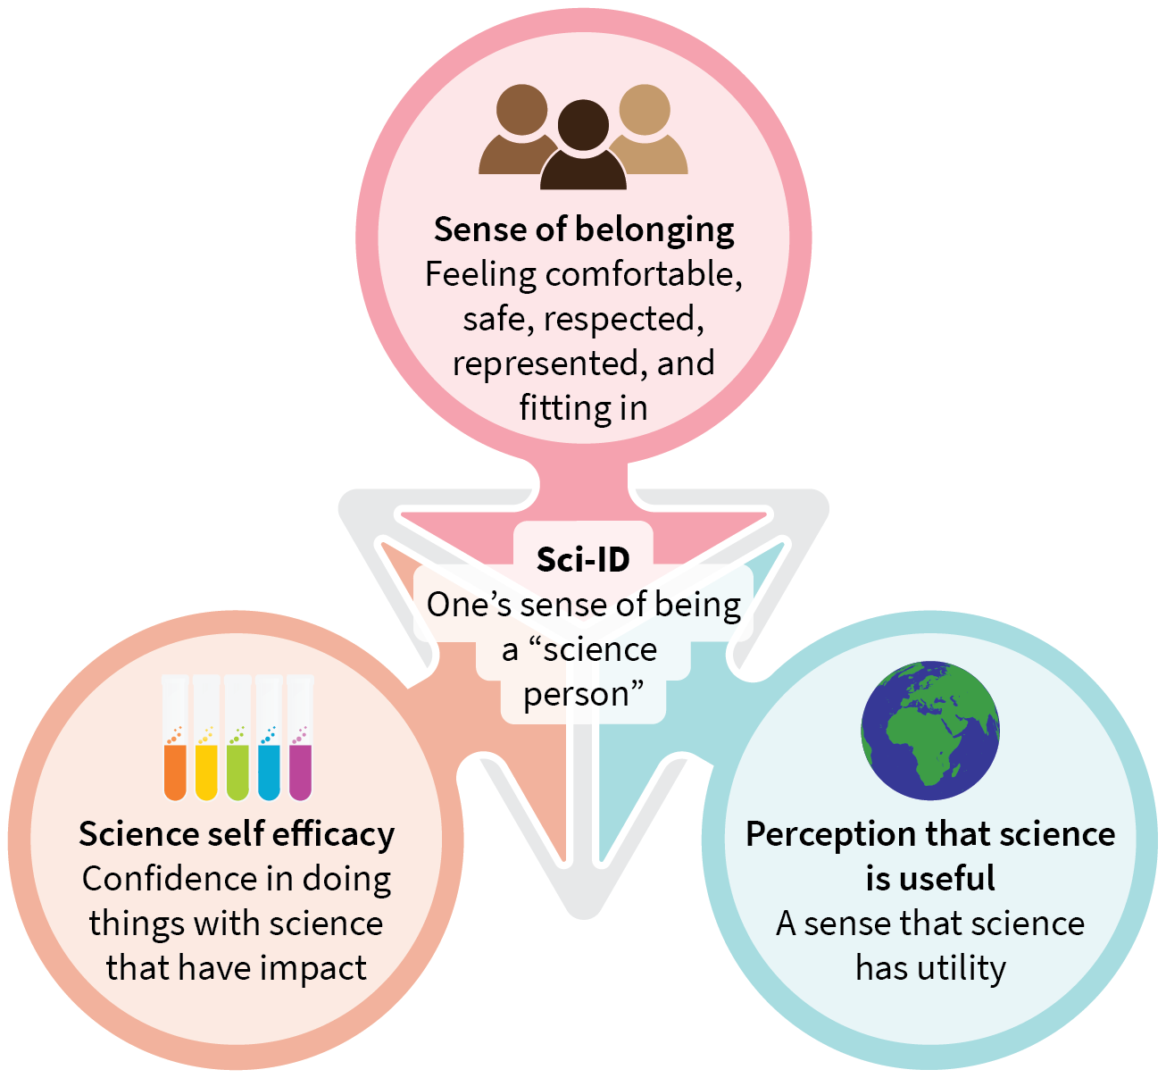
Scientific Identity (Sci-ID) is one’s inner sense of being a “science person”
Emmanuel College Biology Dept. Belonging in Biology Summit 2021

Slide 3
Marginalized students have lower Sci-ID
Oseguera, Leticia et al. (2019). Examining the Role of Scientific Identity in Black Student Retention in a STEM Scholar Program. English. The Journal of Negro Edu-cation88.3.NumPages:229-248,421-422Place:Wash-ington, United States Publisher: Howard University School of Divinity, 229–248, 421–422. ISSN: 00222984.URL:https://search.proquest.com/docview/2423041571 / abstract / BCF980FF8FE74845PQ / 1(visited on 04/21/2021).
Emmanuel College Biology Dept. Belonging in Biology Summit 2021

Slide 4
Tools to Nurture Sci-ID
Academic Literature-Sourced
Glossary of Diversity, Equity &
Inclusion-based Terminology
Research-Based
Domain-Specific
Recommendations
Diverse & Accurate
Representation of Scientists
Emmanuel College Biology Dept. Belonging in Biology Summit 2021

Slide 5
The Glossary
A bank of recommended and unrecommended terms intended to support:
Race & Ethnicity | Sex & Gender | Disability | Sexuality
Religion | Socioeconomic status
▶ recommended terms
Terms that are generally inclusive and suggested for use by individuals that do not identify with the identity
◀ unrecommended terms
Terms that are generally exclusive and not suggested for use by individuals that do not identify with the identity
*It is suggested that individuals who identify with an identity should be empowered to use whatever terminology they please
Emmanuel College Biology Dept. Belonging in Biology Summit 2021
Wagaman, M. Alex (July 2016). Self-definition as resistance: Understanding identities among LGBTQ emerging adults. Journal of LGBT Youth13.3. Publisher: Routledge _eprint:https://doi.org/10.1080/19361653.2016.1185760,207–230. ISSN: 1936-1653. DOI:10.1080/19361653.2016.1185760. URL:https://doi.org/10.1080/19361653.2016.1185760(visited on 04/25/2021)

Slide 6
Recommendations
Professors’ responses to identity- related traumatic events
Use of content warnings for lectures
Equitable expectations for students
Emmanuel College Biology Dept. Belonging in Biology Summit 2021

Slide 7
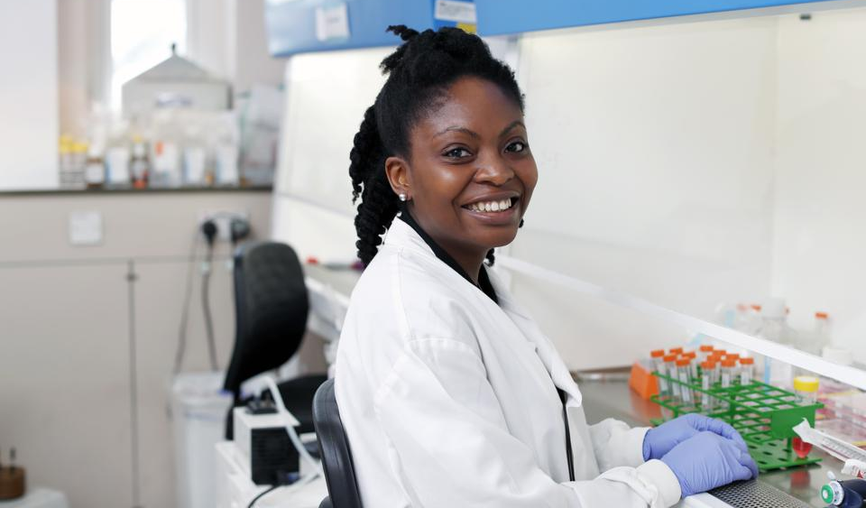
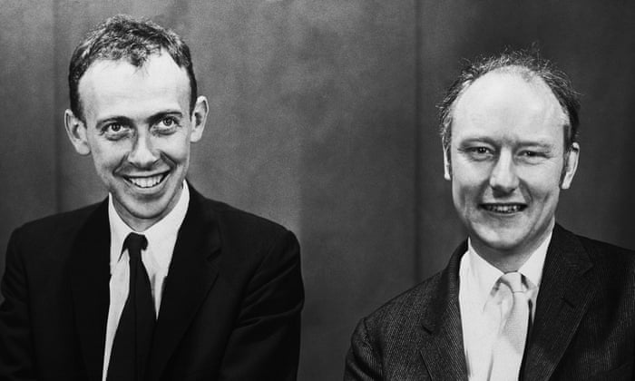
Diverse & Accurate Representation of Scientists
Dr. Kizzmekia Corbett, PhD
Immunologist fighting COVID-19
Watson & Crick
Biologists who stole data from
Rosalind Franklin and published it as
their own
Suggestions? Email them to barronm@emmanuel.edu
Emmanuel College Biology Dept. Belonging in Biology Summit 2021

Slide 8
The Study
Emmanuel College Biology Dept. Belonging in Biology Summit 2021

Slide 9
“Think Tank” Plug!
Emmanuel College Biology Dept. Belonging in Biology Summit 2021

Slide 10
Thanks for your attention! Please email any recommendations, questions, and comments to barronm@emmanuel.edu
Emmanuel College Biology Dept. Belonging in Biology Summit 2021

